Slide 1
Game playing

Slide 2
Outline
Optimal decisions
Min-max Algorithm
α-β pruning
Imperfect, real-time decisions

Slide 3
Games vs. search problems
"Unpredictable" opponent → specifying a move for every possible opponent reply
Time limits → unlikely to find goal, must approximate

Slide 4

Game tree (2-player, deterministic, turns)

Slide 5

Minimax
Perfect play for deterministic games
Idea: choose move to position with highest minimax value
= best achievable payoff against best play
E.g., 2-ply game:

Slide 6

Minimax algorithm

Slide 7
Properties of minimax
Complete? Yes (if tree is finite)
Optimal? Yes (against an optimal opponent)
Time complexity? O(b^{m})
Space complexity? O(bm) (depth-first exploration)
For chess, b ≈ 35, m ≈100 for "reasonable" games
→ exact solution completely infeasible

Slide 8

α-β pruning example

Slide 9

α-β pruning example

Slide 10

α-β pruning example

Slide 11

α-β pruning example

Slide 12

α-β pruning example

Slide 13
Properties of α-β
It is also necessary to modify the branch and bound strategy to include two bounds,one for each of the players.This modified strategy is called alpha-beta Strategy
Pruning does not affect final result
Good move ordering improves effectiveness of pruning
With "perfect ordering," time complexity = O(b^{m/2})
  doubles depth of search

Slide 14

Why is it called α-β?
α is the value of the best (i.e., highest-value) choice found so far at any choice point along the path for max
If v is worse than α, max will avoid it
→ prune that branch
Define β similarly for min

Slide 15

The α-β algorithm

Slide 16

The α-β algorithm

Slide 17
Cutting off search
Change:
  if TERMINAL-TEST(state) then return UTILITY(state)
into
  if CUTOFF-TEST(state,depth) then return EVAL(state)
Introduces a fixed-depth limit depth
  Is selected so that the amount of time will not exceed what the rules of the game allow.
When cuttoff occurs, the evaluation is performed.

Slide 18
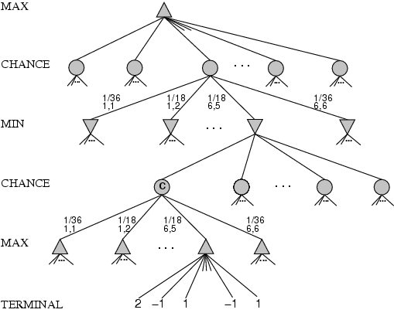
Games that include chance
Possible moves (5-10,5-11), (5-11,19-24),(5-10,10-16) and (5-11,11-16)

Slide 19
Games that include chance
chance nodes
Possible moves (5-10,5-11), (5-11,19-24),(5-10,10-16) and (5-11,11-16)
[1,1], [6,6] chance 1/36, all other chance 1/18

Slide 20
Home Work
Perform the alpha –beta pruning on a tree to improve the Final Decision.
Explain the algorithm of Min-Max decisions with respect to chess game.

